Slide 1

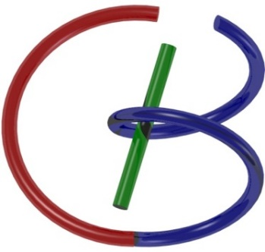
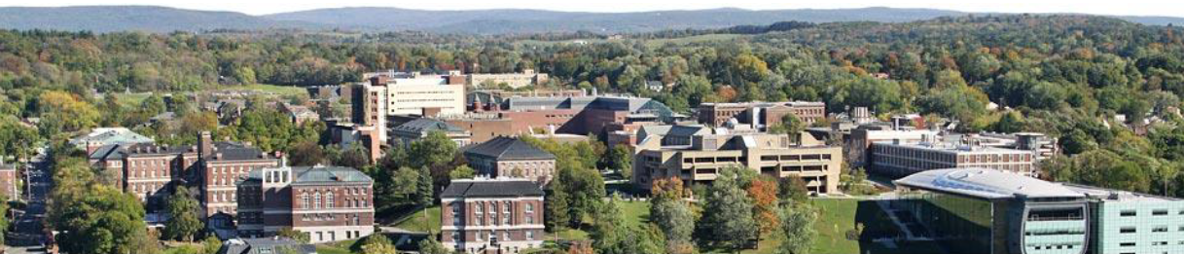
More MRI Stuff
Ge Wang
AI-based X-ray Imaging System (AXIS) Lab
Rensselaer Polytechnic Institute, Troy, New York, USA
October 22, 2021

Slide 2
MI Schedule for F21
Tue | Topic | Fri | Topic
08/31 | Introduction | 09/03 | Neuron, Network & Backpropagation
09/07 | No Class | 09/10 | Hands-on 1: Python, Colab, & TensorF
09/14 | Architectures & Training | 09/19 | Hands-on 2: MNIST Classification
09/21 | Image Quality I | 09/24 | CT Physics
09/28 | CT Reconstruction | 10/01 | Deep CT Reconstruction
10/05 | Hands-on 3: CT Networks | 10/08 | More CT Contents
10/12 | MRI Physics | 10/15 | Spin-Echo
10/19 | K-Space Theorem | 10/22 | More MRI Contents
10/26 | Mid Exam | 10/29 | Deep MRI Reconstruction
11/02 | Hands-on 4: MRI Networks | 11/05 | Nuclear Physics
11/09 | Nuclear Imaging | 11/12 | US Imaging
11/16 | Optical Imaging | 11/19 | Multimodality Imaging
11/23 | Hands-on 5: Image Conversion | 11/26 | Thanksgiving
11/30 | Image Quality II | 12/03 | Stability, Interpretability, & Others
12/07 | Overview | 12/10 | Final Exam
Office Hour: Teaching Day 5-6pm: https://rensselaer.webex.com/meet/wangg6

Slide 3
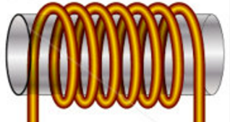
Signal Model for a Whole Object
Rotating Transverse Component of M Induces a Current in Quadrature Coils
In the Rotating Frame:
Repeated after TR:
Total Signal:
z
s_{y}(t)
M
y’
x’
s_{x}(t)
Determined by Proton Density ρ, T₁, & T₂ (Biological)
as well as B₀, TR, TE, & t (Technical)

Slide 4
Fourier Analysis: Formulation

Slide 5
General case: G(t)
è
define
è
Fourier transform:
if and time-independent
then k-theorem
short measurement interval
(read out period) -> t = t*
no motion
(breathing, blood flow, ...)

Slide 6
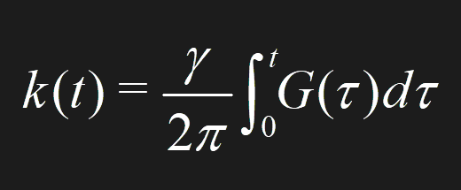
Signal Model with Gradients
Signal Model for a Whole Object in the lab frame
Spin-Echo Signal Model for a Whole Object with a 90˚ Pulse in the Rotating Frame
Trajectory in the k-space
Signal Model with Gradient Fields

Slide 7
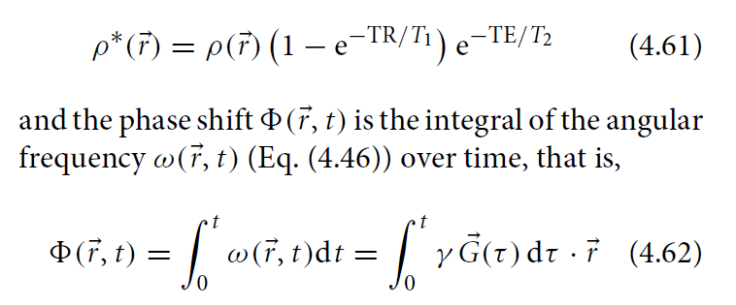
Initial Phase
Over a time interval [0, t], the “phase factor” is given by the above equation (note that the phase increment rate is an inner product of the gradient vector G and the positional vector r).
If you don’t measure over [t, t+Δt] you accumulate the phase factor.
If you measure over [t, t+Δt] you obtain a single k sample at the location determined by the current phase factor.

Slide 8
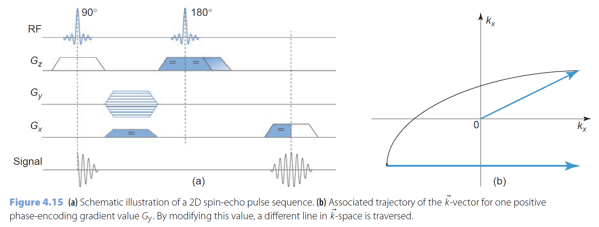
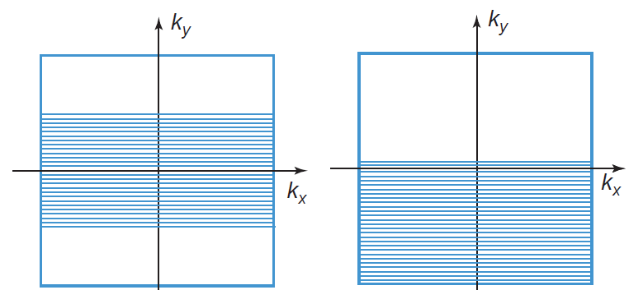
Trajectory in the k-space
Dephasing from midpoint (Eq. (4.42) in BB
Simply put, we can assume the M vector is put into the x-y plane immediately at the midpoint

Slide 9
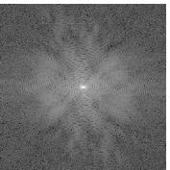
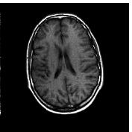
MRI Data & Image
k_{y}
y
s(t) = F(k_{x},k_{y})
f(x,y)
k_{x}
x
k-space
Modulus of s(t) IFT of F(k_{x}, k_{y})

Slide 10
Signal Model with Gradients
Signal Model for a Whole Object in the lab frame
Spin-Echo Signal Model for a Whole Object with a 90˚ Pulse in the Rotating Frame
Relative to ω₀
Voxel-specific angular frequency in the inner product format
Voxel-specific accumulated phase factor
A trajectory point in the k-space after the volumetric integral at time instant t
Signal Model with Gradient Fields

Slide 11
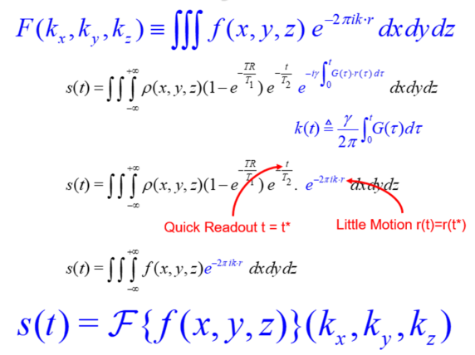
K-Theorem as the Foundation of MRI
This is the standard spin-echo signal model in the rotating frame for a whole object
This defines a “k” point as a function of time in the k-space, still in the rotating frame. Each k point is computed by integrating over the whole object space (the nature of FT)
The Fourier imaging model is again approximate, just like in the CT case
We need to let the “k” point trace the whole Fourier spectral support so that the inverse Fourier transform can be used to reconstruct the original image

Slide 12
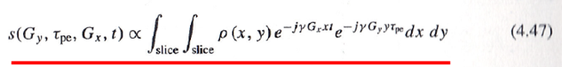
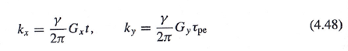
Phase/Frequency Encoding (τ – prep / t - take)
Signal model used in the undergraduate lecture:
γG_{x} t/2π, γ G_{y} τ_{pe}/2π
γG_{x} t/2π, γ G_{y} t/2π
γG_{x} τ_{pe_x}/2π, γ G_{y} τ_{pe_y}/2π
γG_{x} τ_{pe_x}/2π, γ G_{y} t/2π

Slide 13
Outline
More Sequences
Braining Imaging
System Components

Slide 14
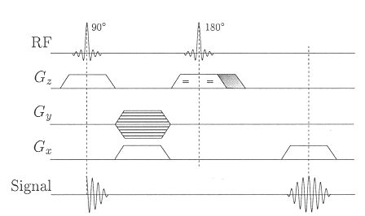
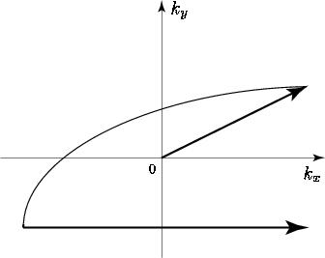
2D Spin-Echo
Dephasing from midpoint (Eq. (4.42) in BB
Ladder
Rephasing
=
=
t=0
t=TE/2
t=TE
Slice Selection Spin-Echo Reading

Slide 15
Reduction of acquisition time
Truncated Fourier imaging Half Fourier imaging
(-) y-resolution
(-) SNR
(-) artifacts
FT of a real function f(x,y,z) is Hermitian (real even, imaginary odd)

Slide 16
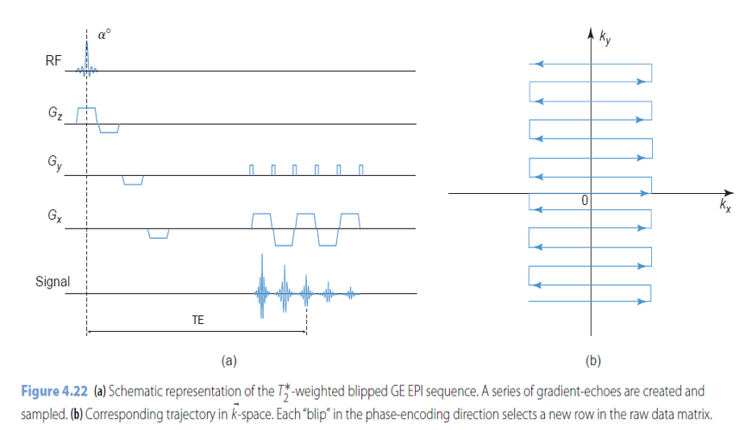
Echo Planar Imaging (EPI for T2*)

Slide 17
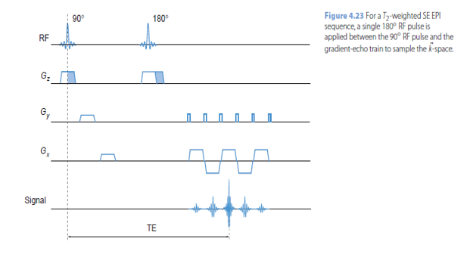

Echo Planar Imaging (EPI for T2)

Slide 18
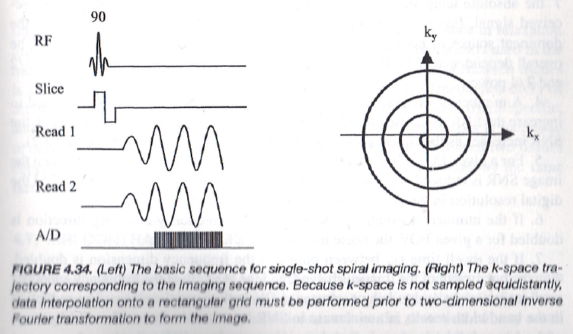
Spiral Imaging

Slide 19
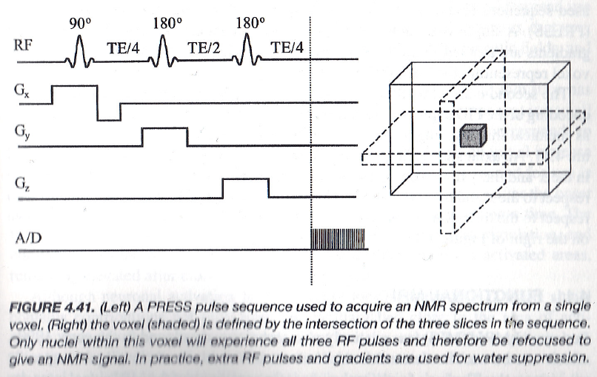
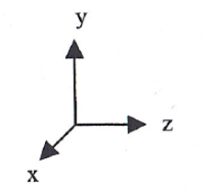
Spectroscopy Method 1: PRESS
(Point Resolved Spectroscopy)

Slide 20
Outline
More Sequences
Braining Imaging
System Components

Slide 21
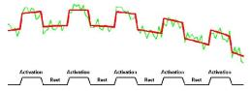
Functional imaging
Oxygen in the blood influences the MR signal. This is known as the BOLD (blood oxygenation-level dependent) effect.
active brain cells -> oxygen consumption -> blood flow overcompensates -> oxygen concentration
deoxyhemoglobin (oxygen-poor hemoglobin): paramagnetic -> T₂* -> T₂* of active brain tissue > T₂* tissue at rest

Slide 22
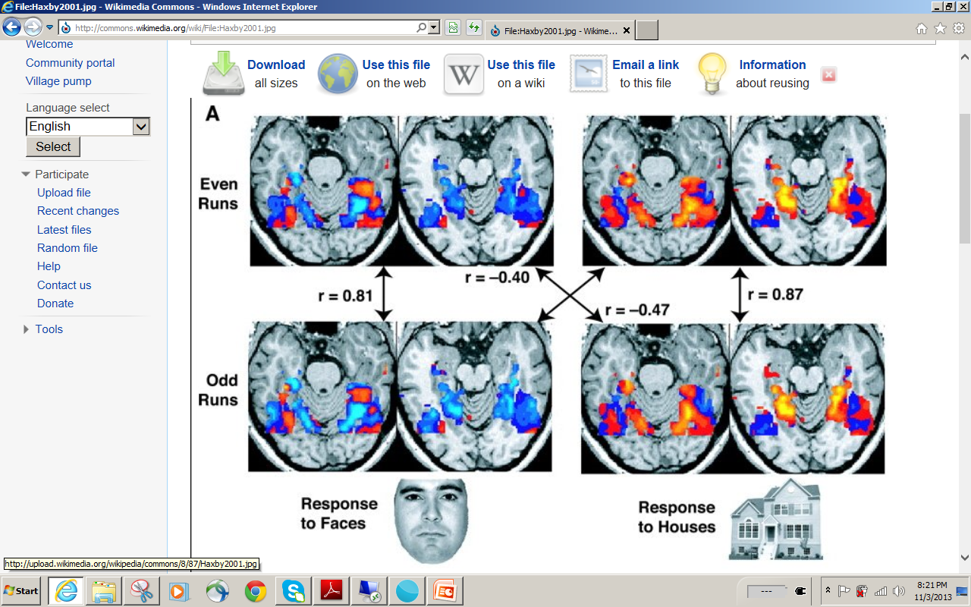

Slide 23
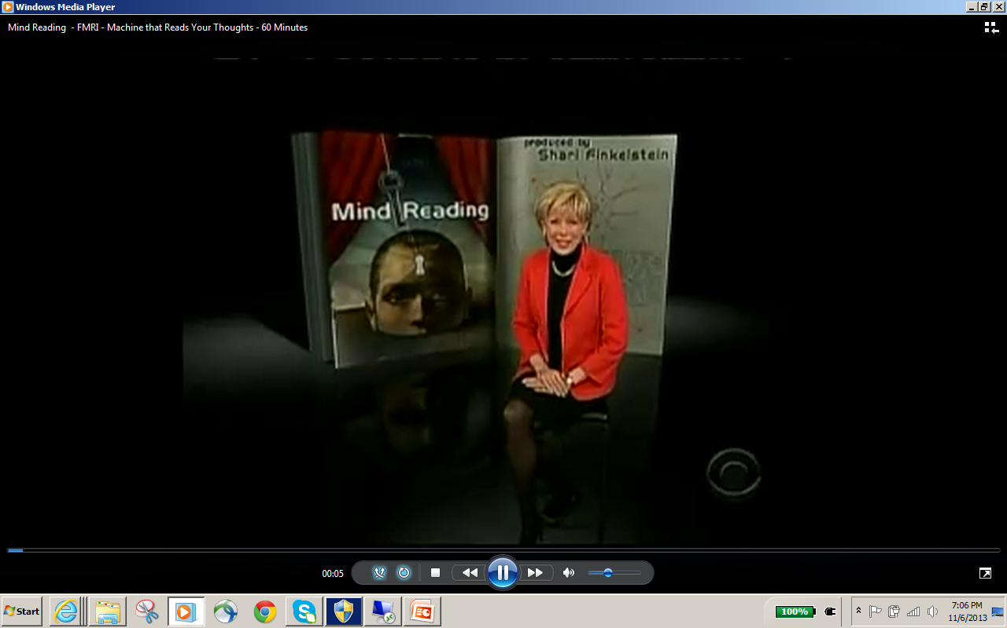
https://www.youtube.com/watch?v=IGwMmhltei4

Slide 24
Outline
More Sequences
Braining Imaging
System Components

Slide 25
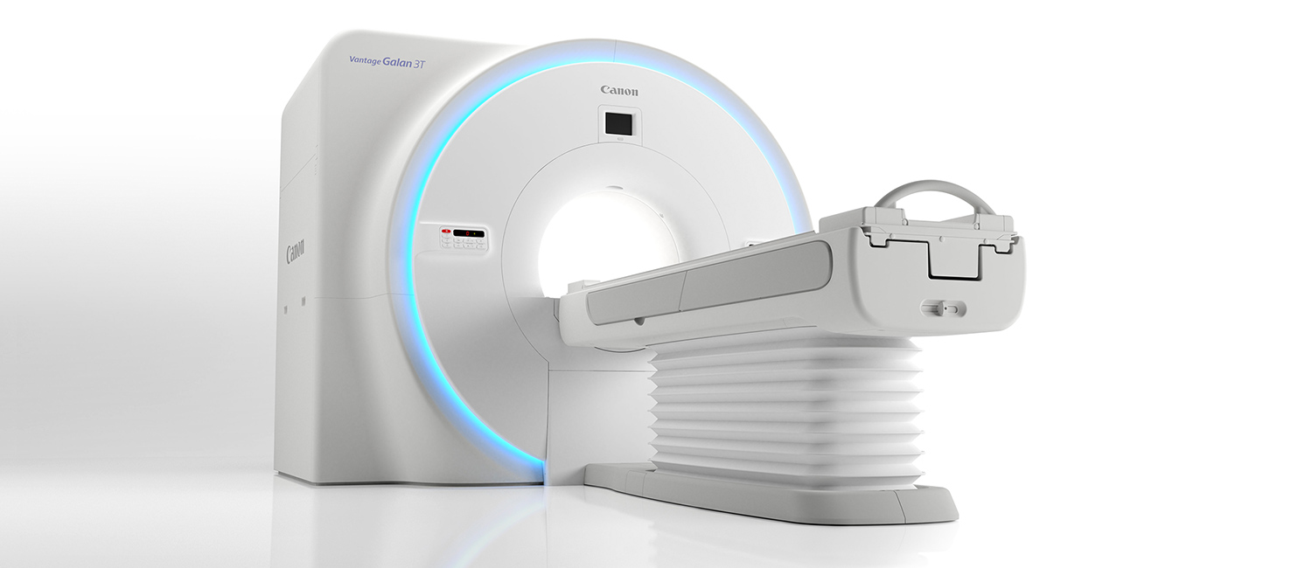
MRI Scanner

Slide 26
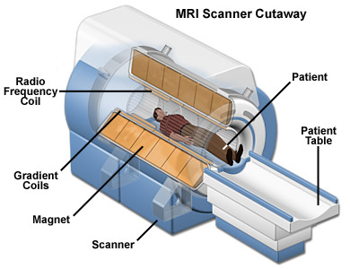
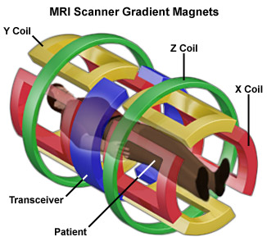
MRI System Diagram
https://nationalmaglab.org/education/magnet-academy/learn-the-basics/stories/mri-a-guided-tour

Slide 27
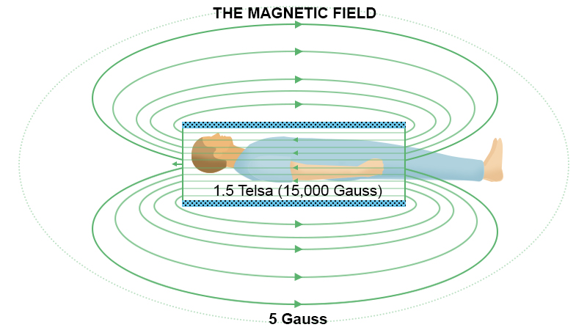
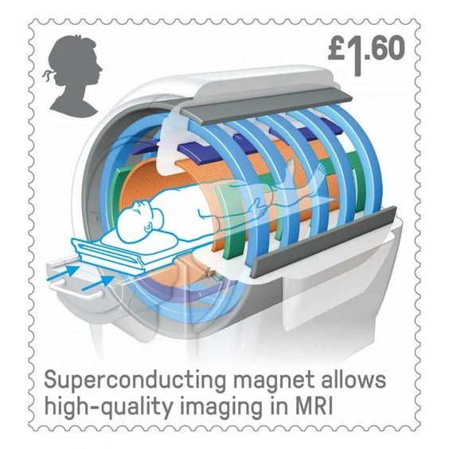
Superconducting Magnet
https://www.eeweb.com/mri-machine/

Slide 28
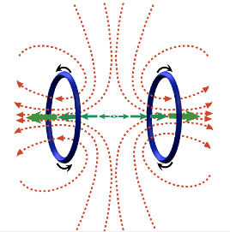
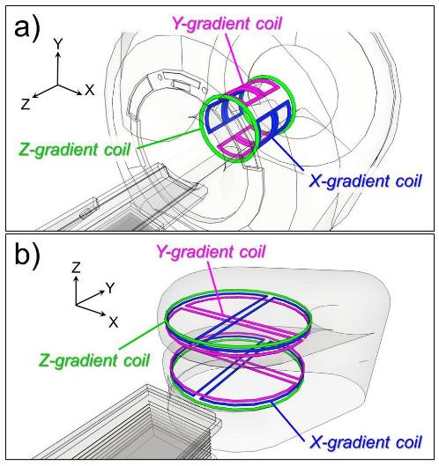
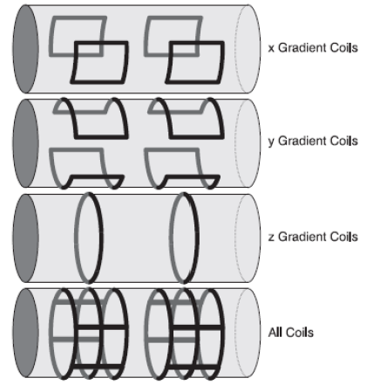
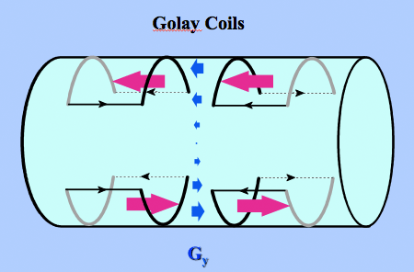
Gradient Coils
Longitudinal Gradient
Transverse Gradient

Slide 29
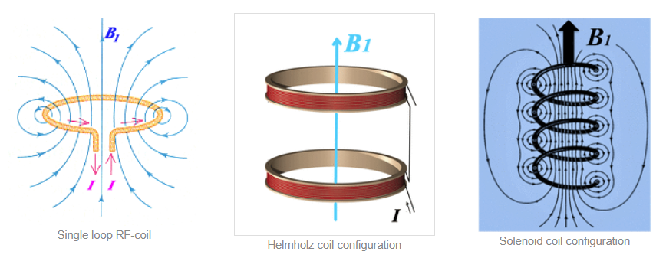
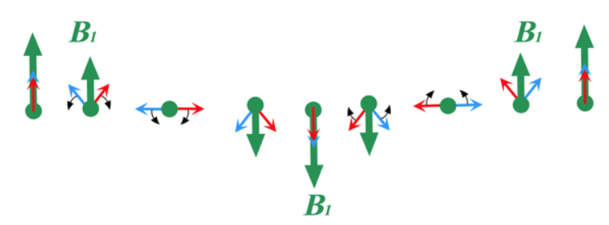
Simple RF Coil
http://mri-q.com/rf-transmit-coils.html

Slide 30
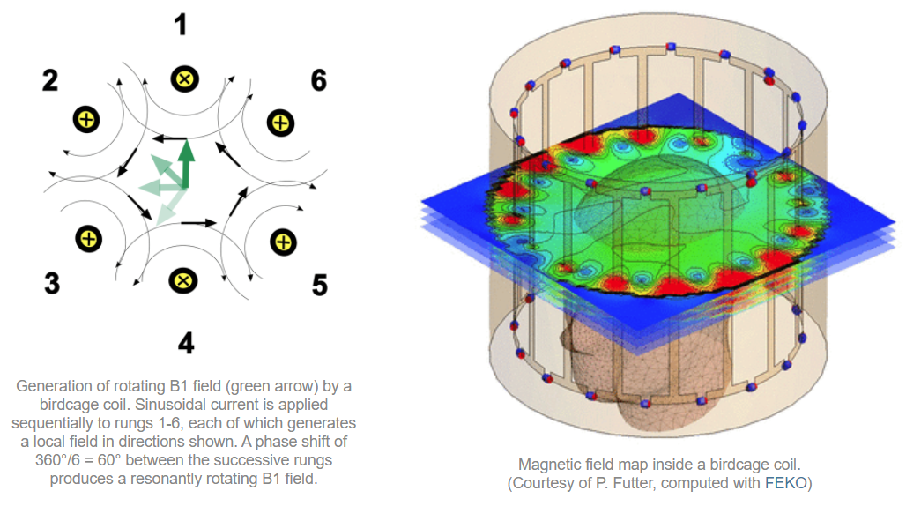
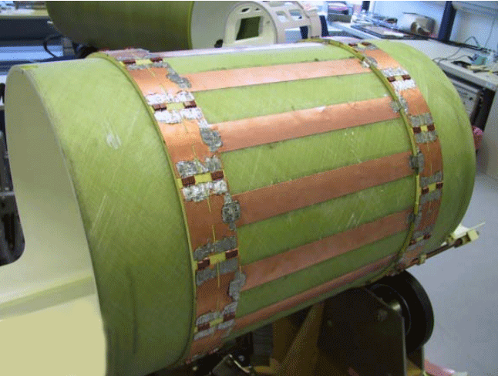
Practical RF Coil
To make sure this rotating field is perpendicular to the B0 field
http://mriquestions.com/birdcage-coil.html

Slide 31

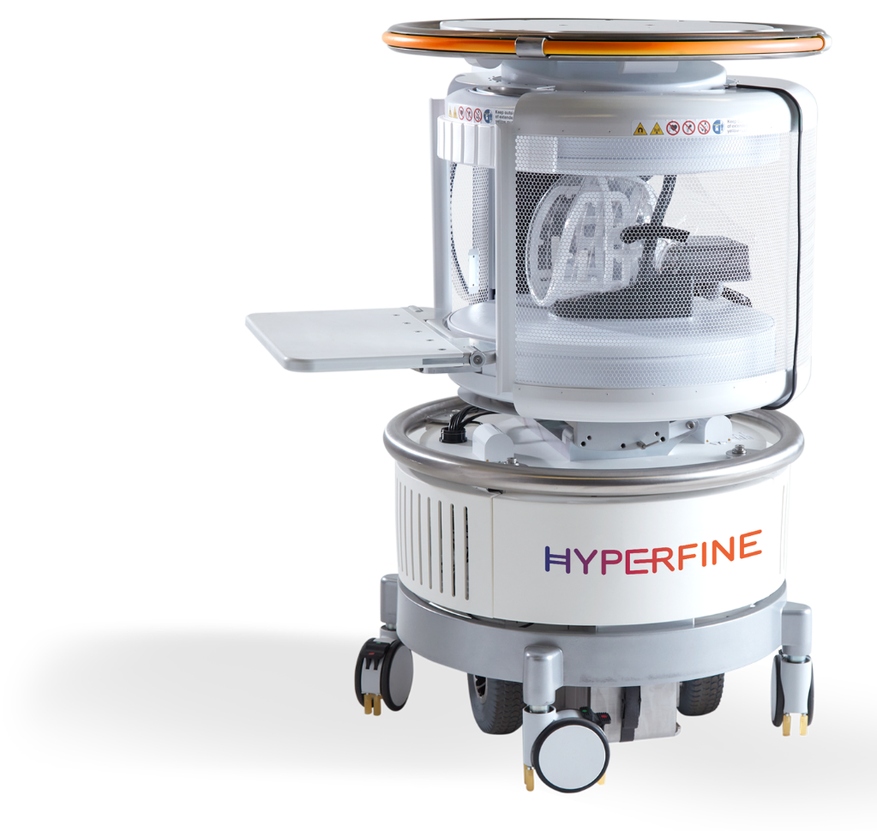
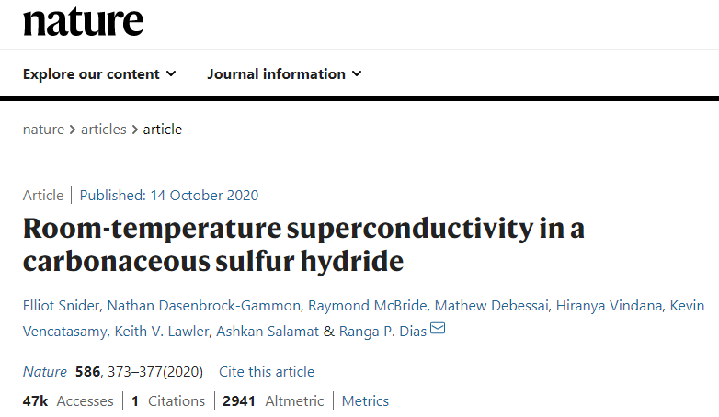
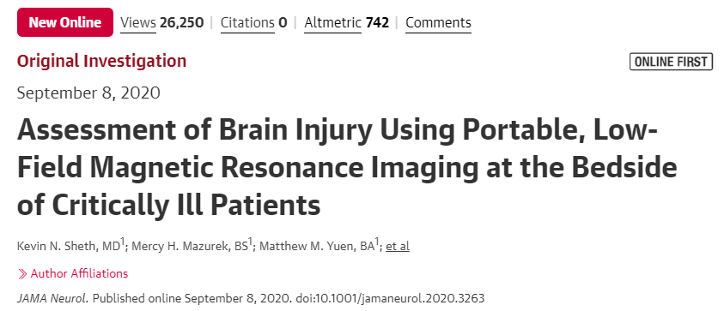
Latest Progresses
At the ready.
See the gallery
See it in action
USE CASES:
ICU Settings
Swoop™ is able to perform serial imaging, which allows a patient’s condition to be monitored over time.
Explore
USE CASES:
Emergency Care
With Swoop™ in the emergency room, healthcare providers have an immediate and low-cost imaging option right where they need it, to make informed and timely decisions.
Explore
USE CASES:
Pediatrics
Swoop™ enables immediate scanning right at a child’s bedside.

Slide 32
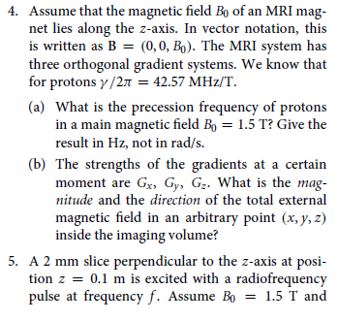
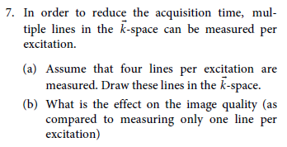
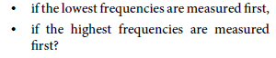
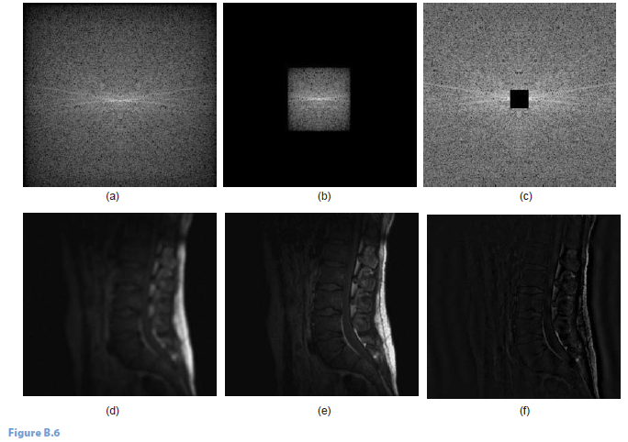
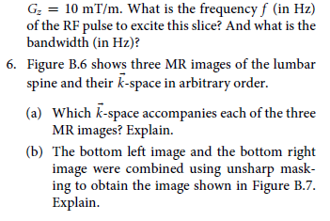
Homework
Do the problems #4-7 from the MRI chapter
Graph & explain EPI & PRESS
Midterm Review: https://rensselaer.webex.com/webappng/sites/rensselaer/recording/9667f8c1f77042c6b6d743bdc97636c8/playback

